Slide 1
GO Games Workshop
County
Crest
Provincial
Crest
Presenter, Macartan McKenna, Brian Laverty, Fiachra Mc Nulty
Date, 26/3/25

Slide 2
What ARE Go Games?
Definition - Go Games are modified small-sided versions of Hurling, Camogie, Gaelic Football and Ladies Gaelic Football which have been devised to cater for the development needs of children aged 7 and up to and including 12 years of age. Go Games can be played in a club, school and/or community setting to introduce children to Gaelic Games. They allow children to have fun, grow, and learn, physically, socially, and psychologically and develop the key attributes for life. Go Games are inclusive, structured to cater for the needs, abilities and backgrounds of all participants.

Slide 3
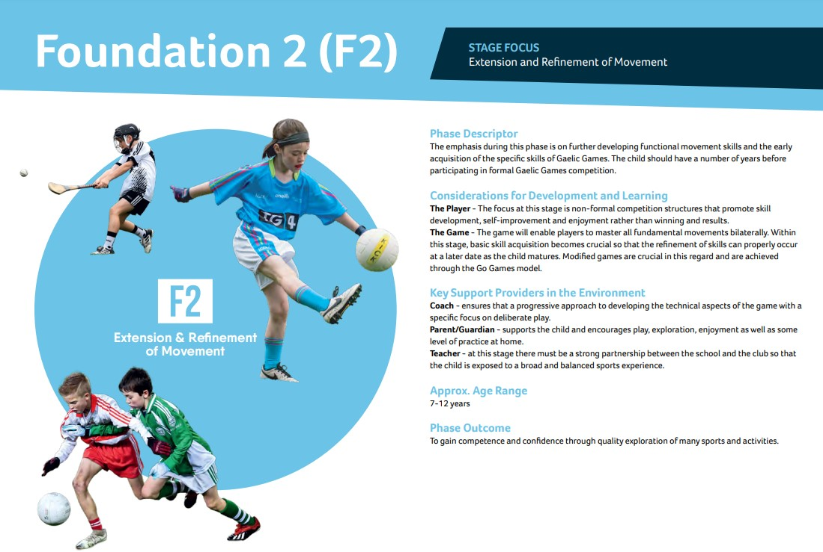
What ARE Go Games?
Activity Planner
GAA Player Pathway
Notes:
It consists of three main pathway phases; Foundation, Talent and Elite/High Performance which in turn, are further sub-divided into eight sub-phases. The pathway is not linear with the players connection with their club maintained even if they play at inter-county level.
Where do they sit within the pathway – F2
The Player - The focus at this stage is non-formal competition structures that promote skill
development, self-improvement and enjoyment rather than winning and results.
The Game - The game will enable players to master all fundamental movements bilaterally. Within
this stage, basic skill acquisition becomes crucial so that the refinement of skills can properly occur
at a later date as the child matures. Modified games are crucial in this regard and are achieved
through the Go Games model.

Slide 4
Key Principles underpinning Go games
Safe Environment
Progressive & Fun
Everyone ‘Has a Go’
Small-Sided Games
U7 to U12 inclusive
Respect

Slide 5
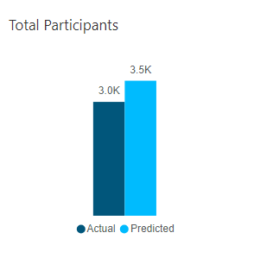
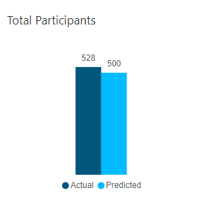
Football
Hurling
Notes:
What is a Go Games Blitz Opportunity: A Go Games blitz opportunity is defined as games formally organised and/or approved by
the county under the Go Games fixtures programme, where either multiple or once off games are played relevant to the specific
age grade(s) and National Go Games policy.
How to calculate Blitz Opportunities: Every fixture day is defined as 1 opportunity rather than counting 3 x 20 min games as 3
separate opportunities.

Slide 6
Go Games Regulations
Go Games are subject to general rules of each Association
To maximise playing opportunities teams shall endeavour to play the minimum numbers recommended; U8.5 – 6 V 6, U10.5 - 8 v 8.
Participants may play up two Go Games age grades – Under 7 may play at their own age grade plus Under 8 or Under-9 level; Under 8 can play their own age grade and Under 9 or Under 10 level Under-9 may play at their own age grade plus Under 10 or Under 11. Under 10 can play their own age grade and Under 11 or Under 12 for example
In Clubs and Primary Schools, up to under 11, no League or Championship competitions shall be organised
No provision is made to publish scores. Go Games should not be used, publicly or otherwise, as grading for any older age grades. No scores should be kept or utilised in any way.
No provision is made to present trophies, cups, etc. Where certificates/medals are presented in lieu of participation, the same certificate/medal must be presented to every participant vii. Club and Primary School blitzes shall be organised subject to Association rule. No provision is made for the organisation of club or primary school Go Games blitzes with formats that include, knock-out games, semi-finals, finals etc.
Notes:
New policy was working project with LGFA & Camogie to integrate and align our programme across the 3 associations

Slide 7
BASIC rules
- U8.5 – Minimum 5 a-side Max 7 a–side
- U10.5 - Minimum 7 a-side Max 9 a–side
- 2 Touch Rule
Player fouled takes the free
Tap and Go can be encouraged at U10.5
Dissent rule for both players and managers to be encouraged at both age grades

Slide 8
Notes:
Move from having subs to creating more pitches, smaller dimensions

Slide 10
Host GO - gAMES DATES
Week 1 - 12th April Donaghmore Killyclogher Rock Castlederg Dromore Killeeshil Aghyaran Moy Ardboe Eskra Stewartstown Garvaghey | Week 2 – 26th April Drumragh Dungannon Fintona Derrytresk Beragh Moortown Clogher Loughmacrory Strabane Gortin Pomeroy Garvaghey | Week 3 – 10th May Errigal Aghaloo Edendork Omagh Naomh Eoghan Trillick Greencastle Derrylaughan Urney Drumquin Coalisland Garvaghey | Week 4 – 24th May Brackaville Clonoe Cookstown Carrickmore Eglish Galbally Glenelly Kildress Owen Roes Tattyreagh Killyman Garvaghey | Week 5 - 7th June Donaghmore Killyclogher Rock Castlederg Dromore Killeeshil Aghyaran Moy Brocagh Augher Stewartstown Garvaghey
Week 6 – 21st June Drumragh Dungannon Fintona Derrytresk Beragh Moortown Clogher Loughmacrory Strabane Gortin Pomeroy Garvaghey | Week 7 - 19th July Errigal Aghaloo Edendork Omagh Naomh Eoghan Trillick Greencastle Derrylaughan Urney Drumquin Coalisland Garvaghey | Week 8 – 2nd August Brackaville Clonoe Cookstown Carrickmore Eglish Galbally Glenelly Kildress Owen Roes Tattyreagh Killyman Garvaghey | Week 9 – 23rd August Donaghmore Killyclogher Rock Castlederg Dromore Killeeshil Aghyaran Moy Ardboe Eskra Stewartstown Garvaghey | Week 10 – 6thSeptember Drumragh Dungannon Fintona Derrytresk Beragh Brocagh Augher Loughmacrory Strabane Gortin Pomeroy Garvaghey

Slide 11
Format for Organising
- All lead coaches added to county Whatsapp group
10 days before scheduled date clubs will be asked to submit their numbers available for the up-coming date
- Once all clubs have submitted numbers, they will be designated to one of the host clubs
Host clubs and attending clubs will then be responsible for communicating with each other beforehand
Host club to issue fixtures, pitch layout and any other information regarding the day at the club

Slide 12
Coaches and Parents Workshop
Go Games Workshop

Slide 13
Online Application
To apply to organise a Go Games Blitz between more than one Club or School can apply thorough the online link
Application Form

Slide 14
Approvals Process
Why the approvals process is required -
Insurance
Compliance with Policy
Aligns with county games programme
Record of games activity

Slide 15
Approvals Process
Internal County Blitz
Cross County Blitz
Cross Provincial Blitz
Club Application Submitted
Reviewed By County Games Manager
Approval / Rejection
Club Application Submitted
Reviewed By
Provincial Games Development Manager
Approval / Rejection
Club Application Submitted
Reviewed By
Ciaran Kearney National Development Competitions Coordinator
Approval / Rejection

Slide 16
Contact information
Presenter name Brian Laverty / Macartan McKenna / Fiachra McNulty
Email address and/or mobile number, brian.laverty.chg.tyrone@gaa.ie
GAA Go Games
GAA Player Pathway
Activity Planner
Learning.gaa.ie

